Slide 1
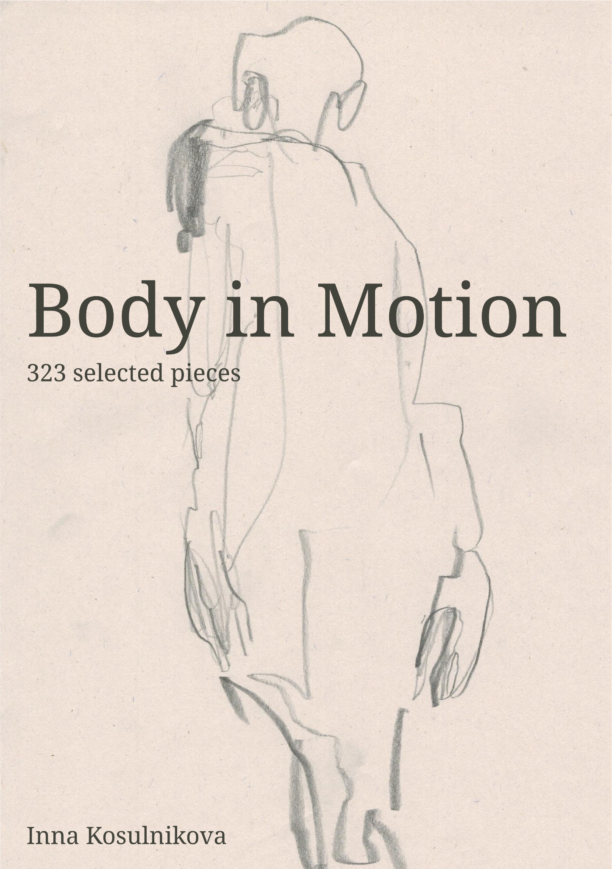
Album with personal drawings. Almanac of essays on the topic of physicality, various assemblies and states of the body, I studied the body as biological matter a faceless, non-personalized body, a dense body, movable, immovable and moving body, as a collection of data, sensors and digital objects, a passive body, an indifferent exposed body, an active questioner, looking at itself.

Slide 2
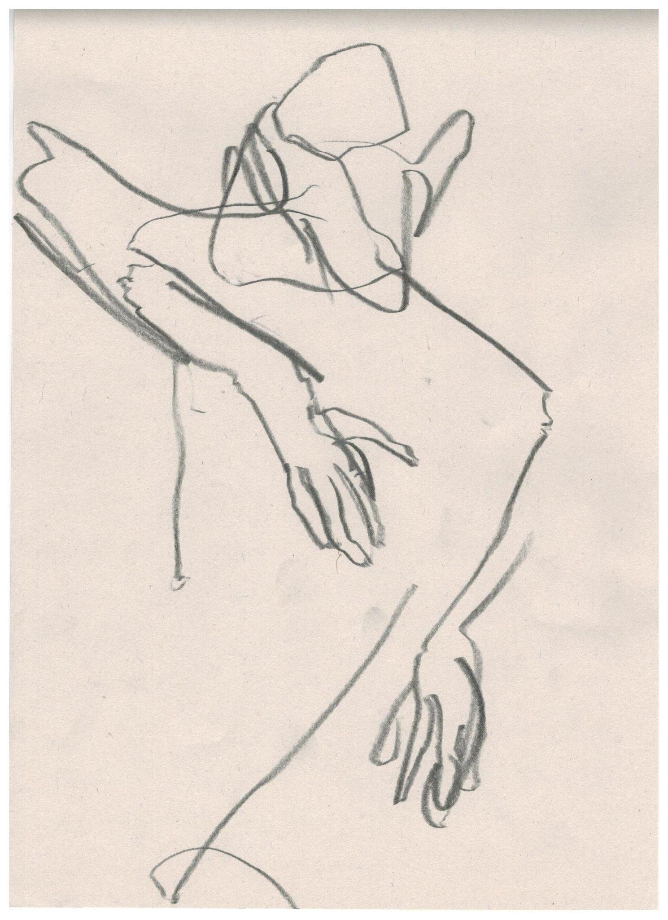
body presenting: unapologetic, solid, taking space which becomes their own, soil, not artistical but biological sense
moving body: disappearing in the movement, melting, dissolving, water, prolonged time
disappearing body: air, wind, nomadic impulses, creating a net (rhysomatic), giving space to the viewer, labyrinth, body without organs, time collapsing
poetic: strong connection, attitude, symbolic (in benjamin's sense of eternal and conserved meaning), fire, flashbulb memory
graphite: futuristic, kinetics, body machine, energy, time vanishing without any observer (the eternal time of technic running, perpetum mobile)
other experiments: attachement to the performative site of human existence is always present

Slide 3
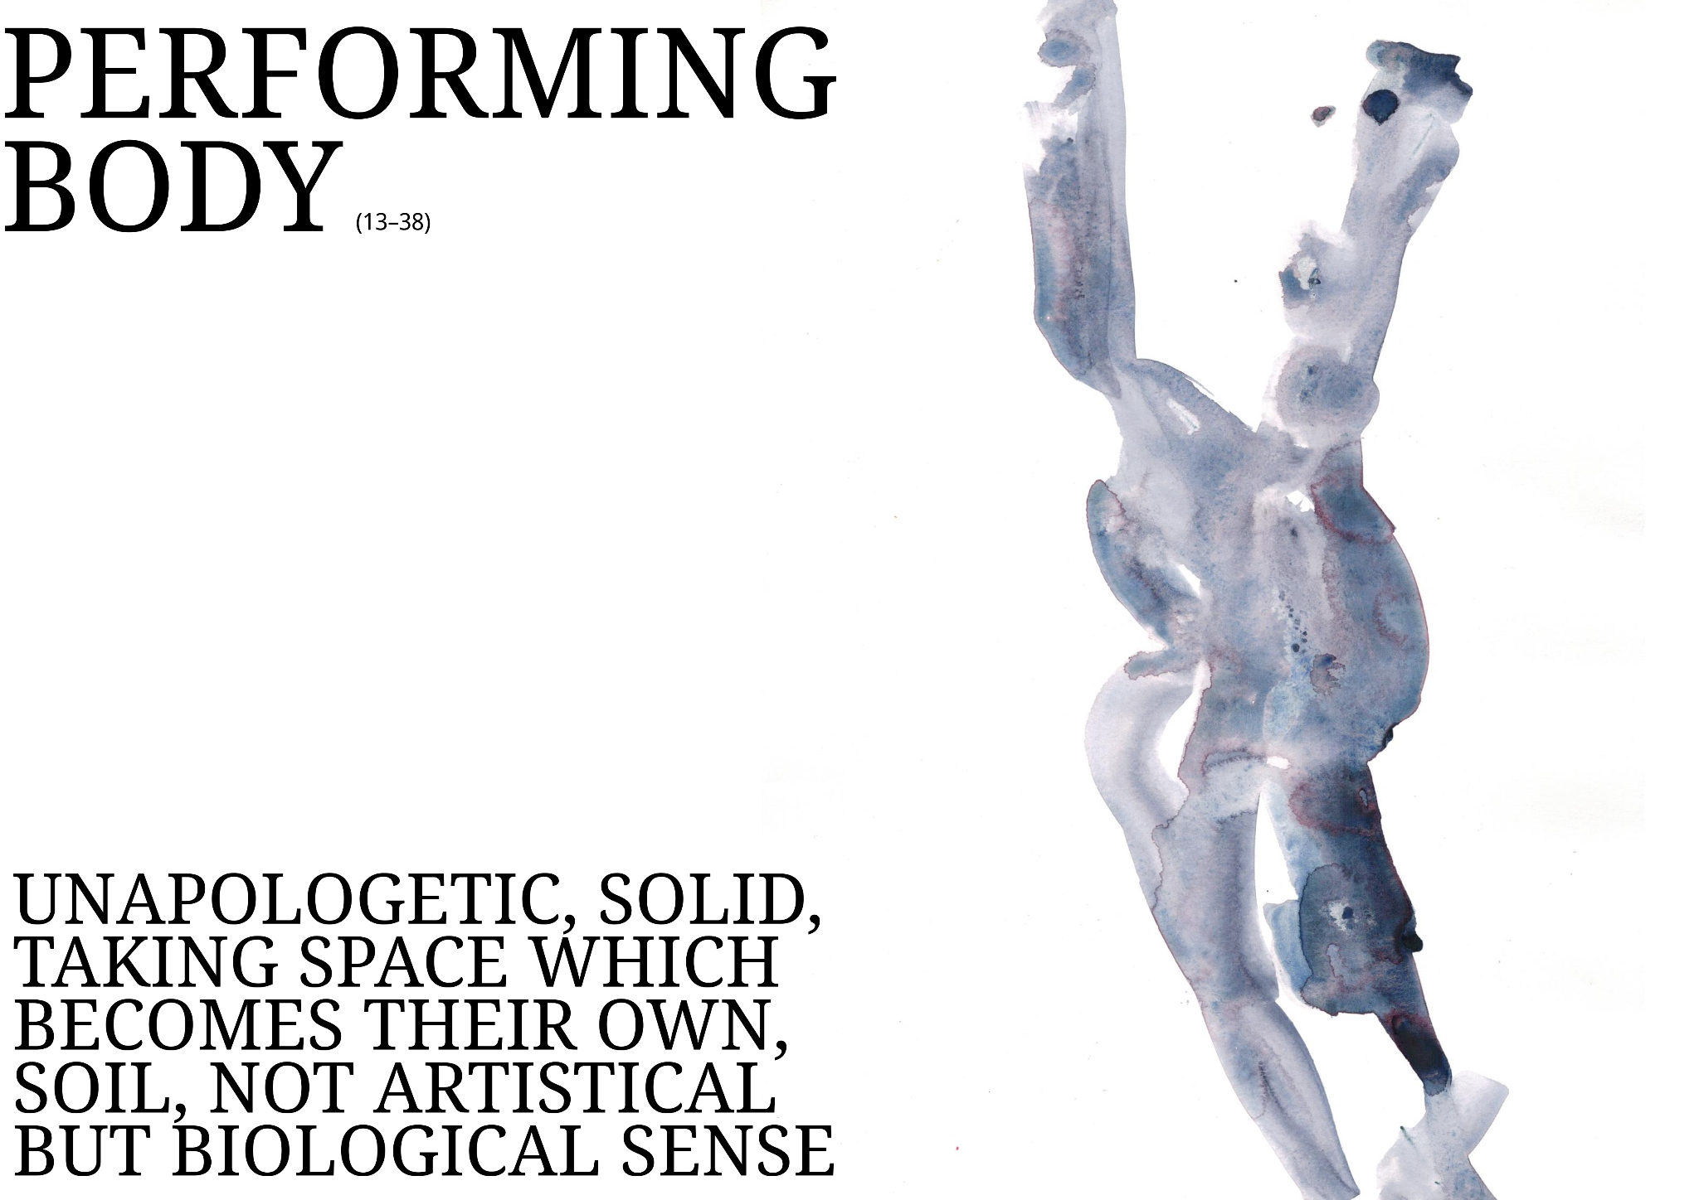

Slide 4
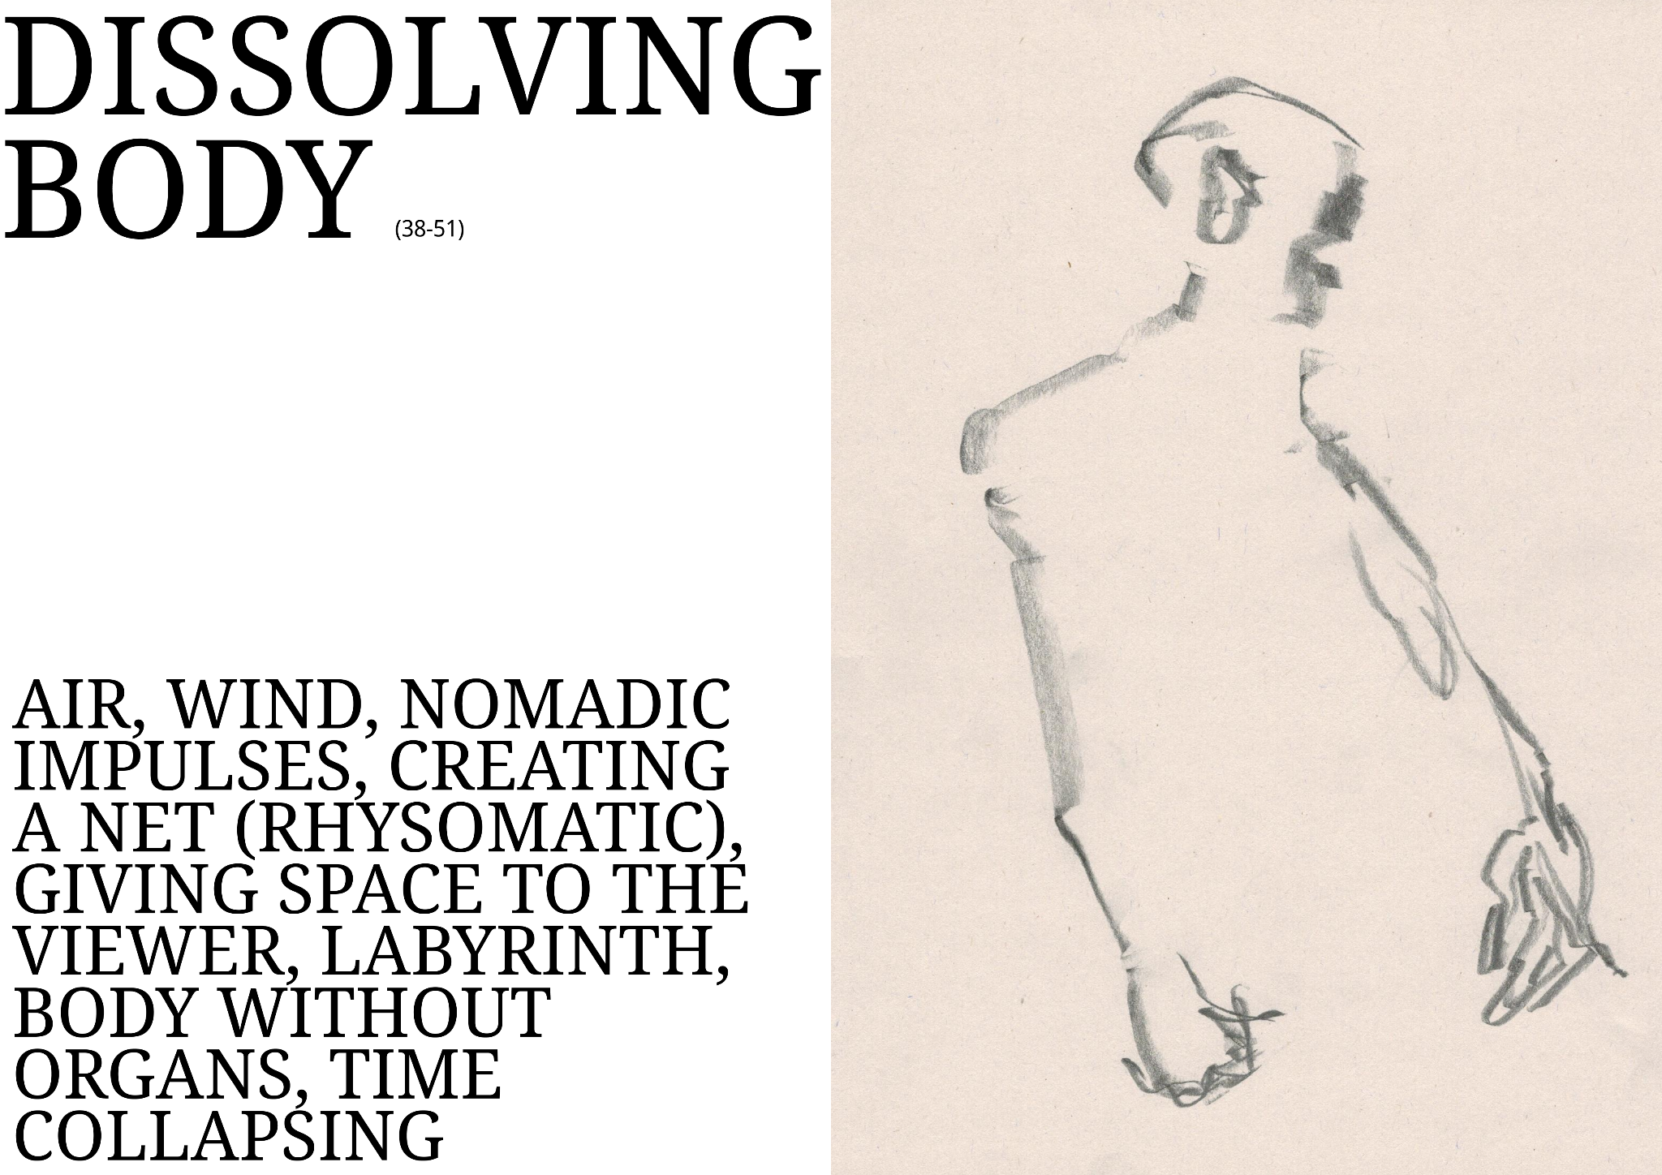

Slide 5
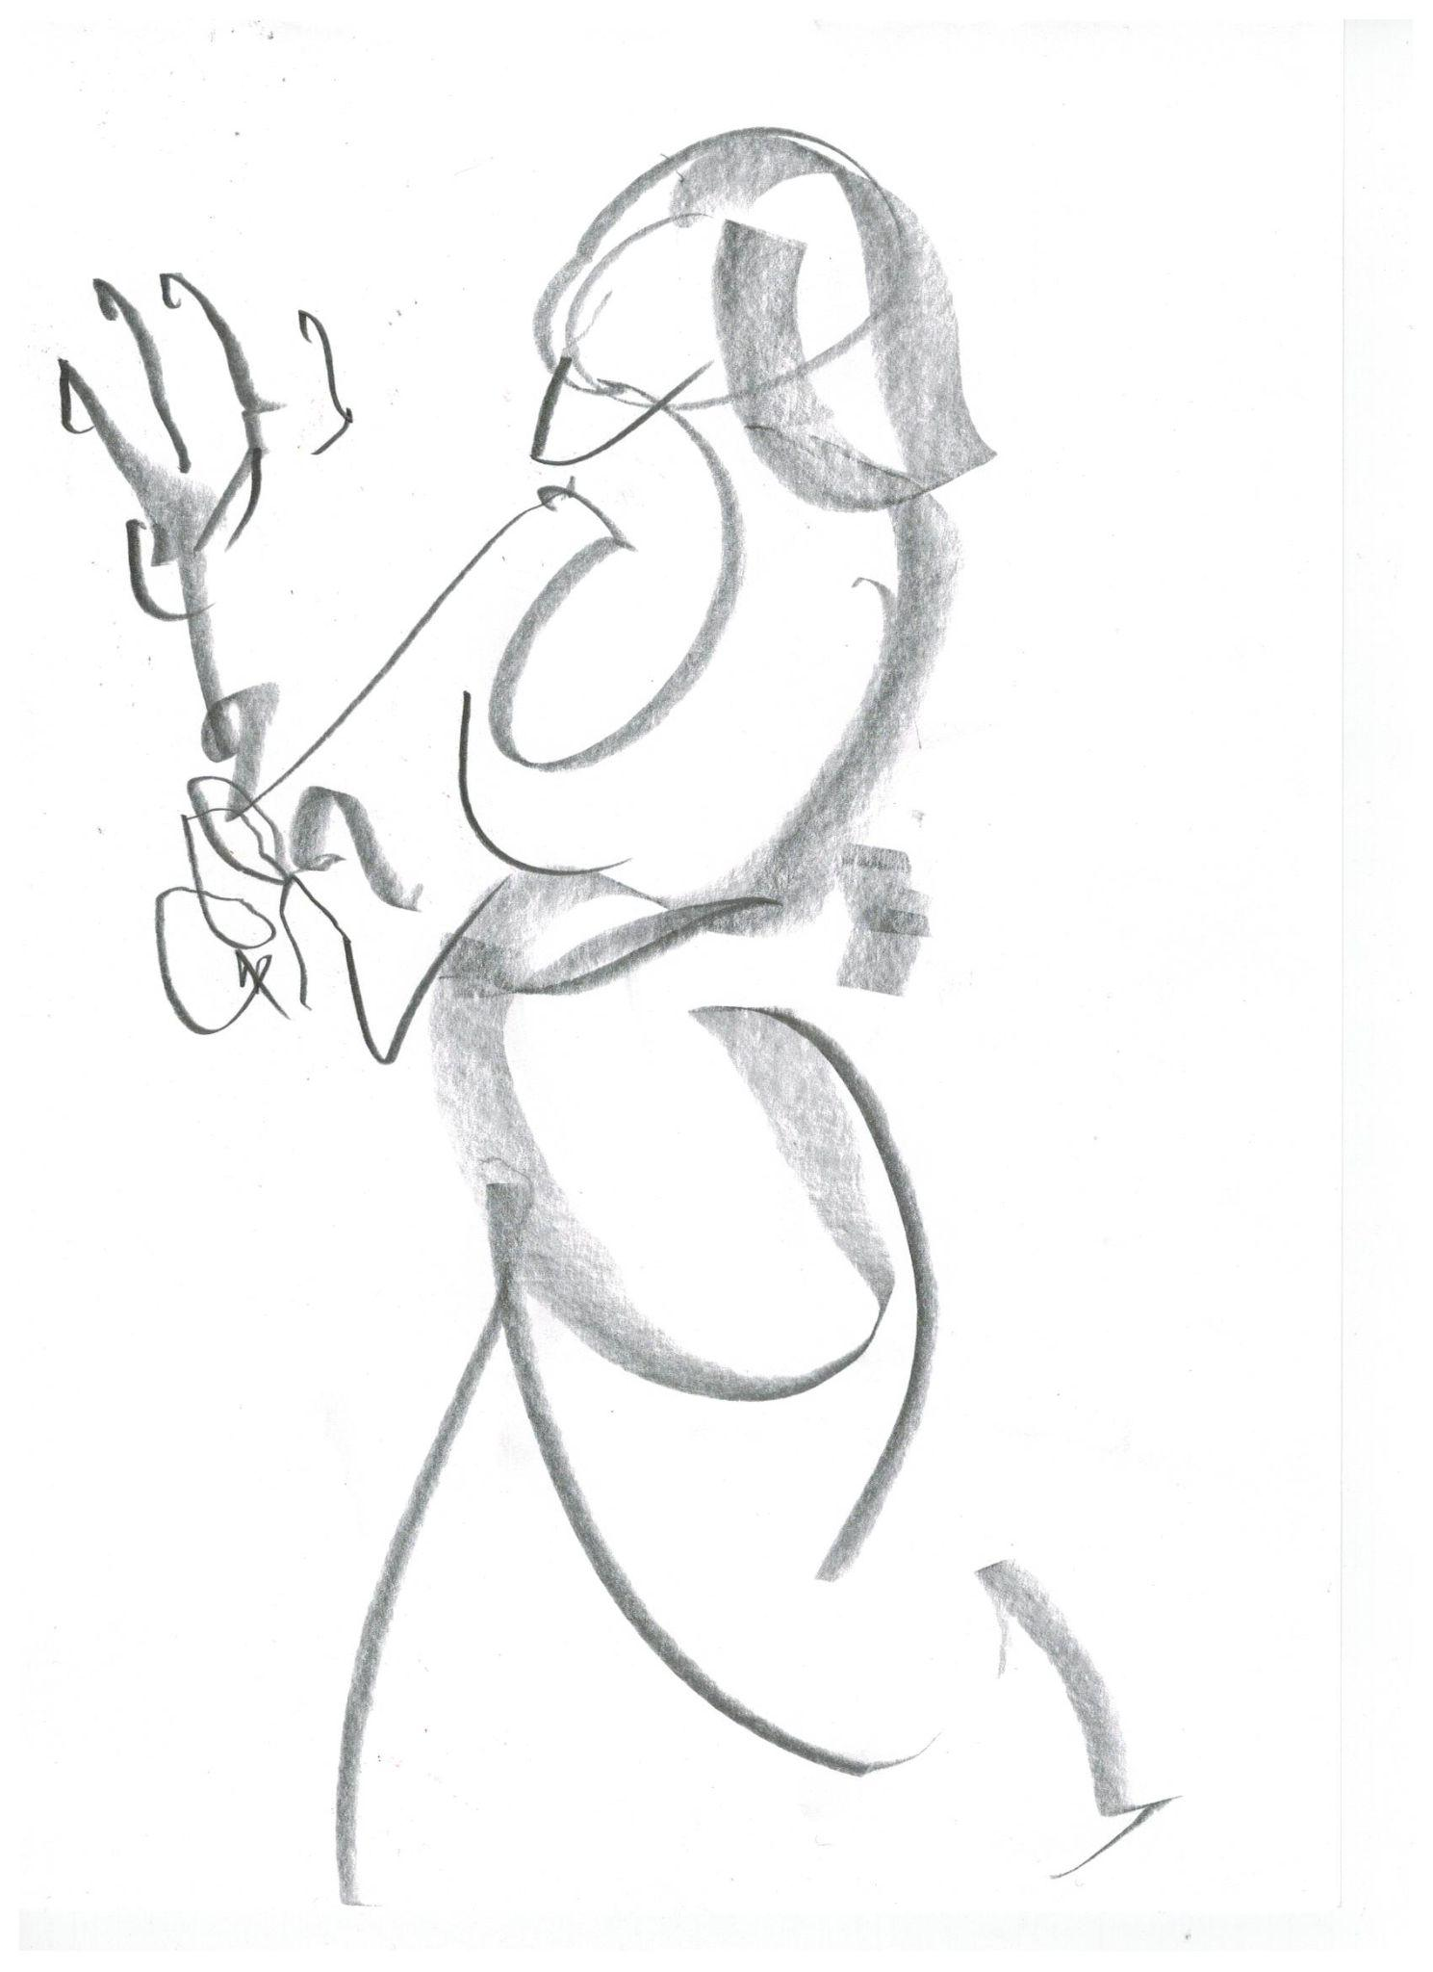
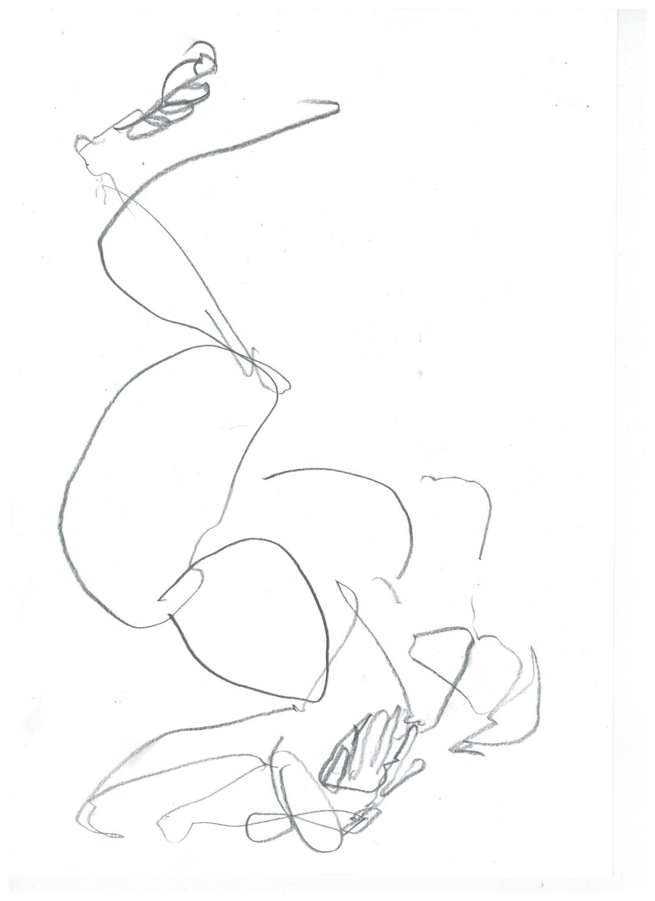

Slide 6
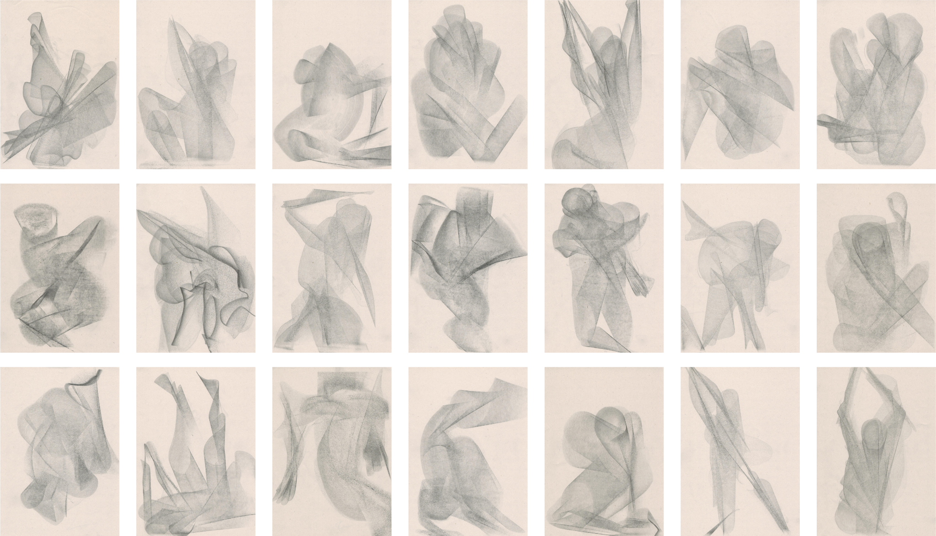

Slide 7
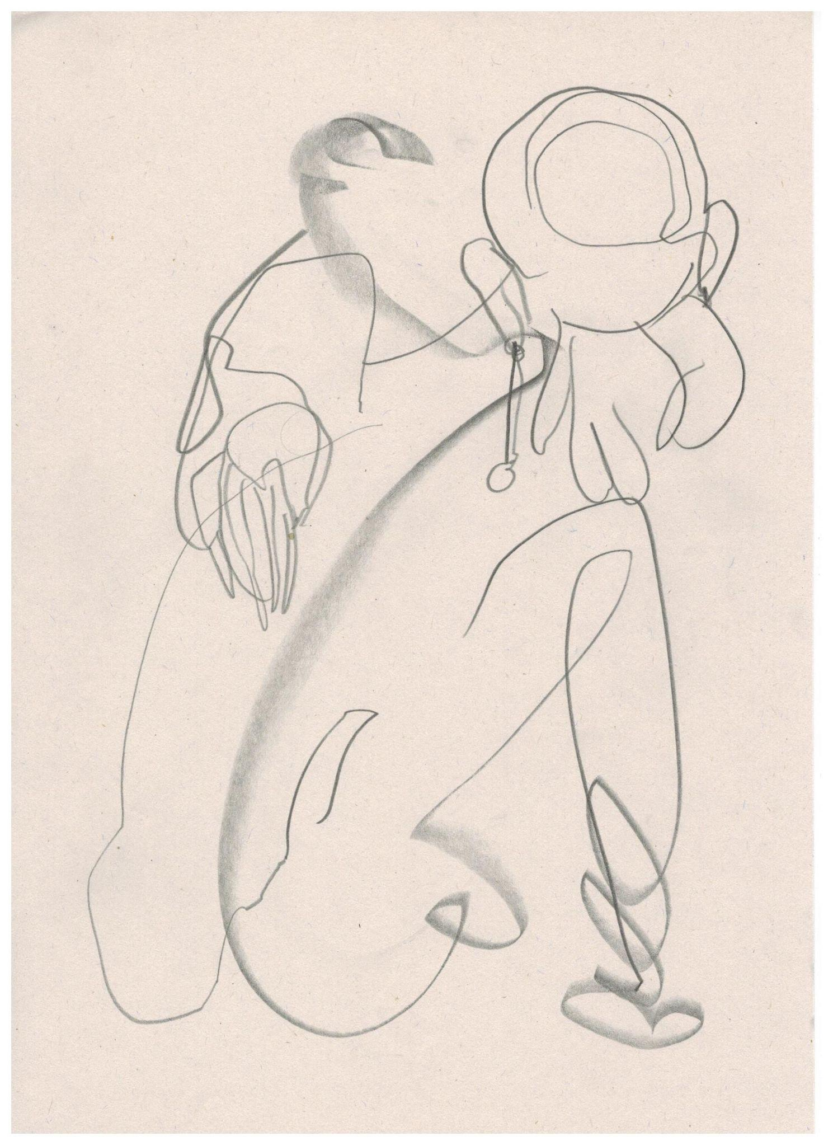
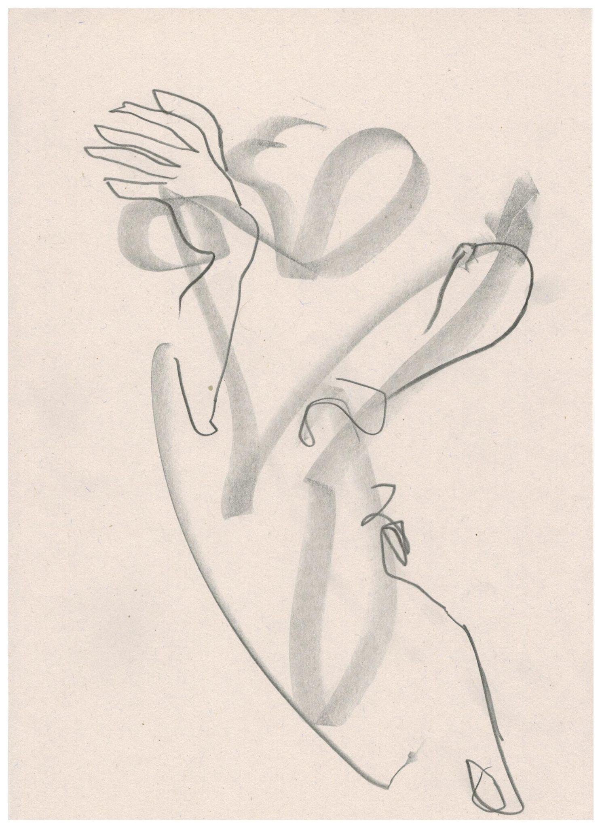
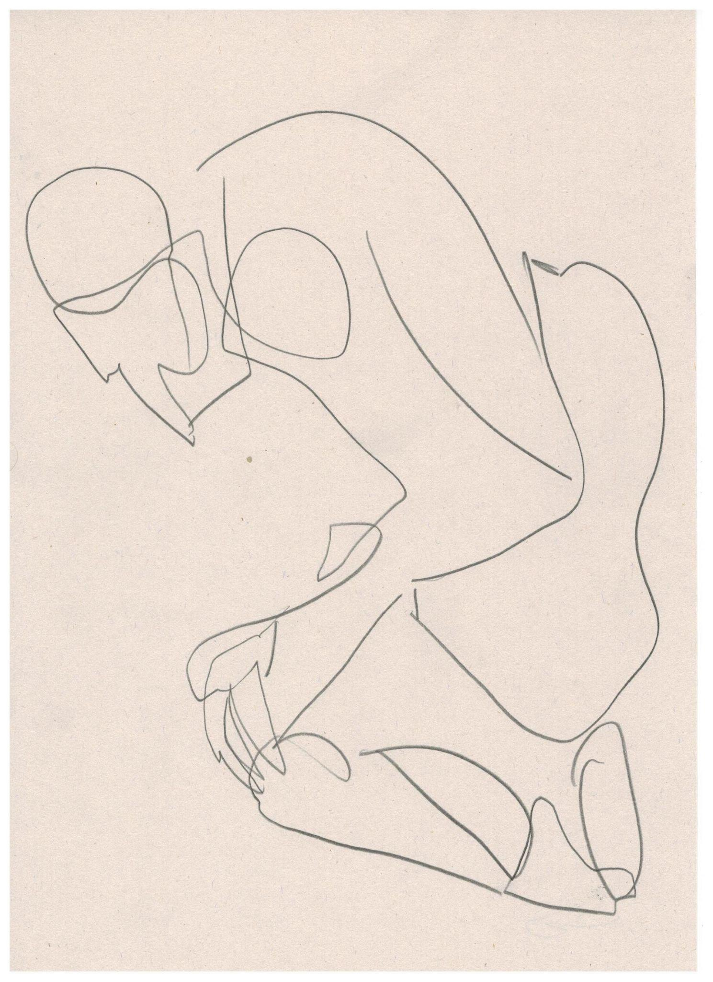

Slide 8
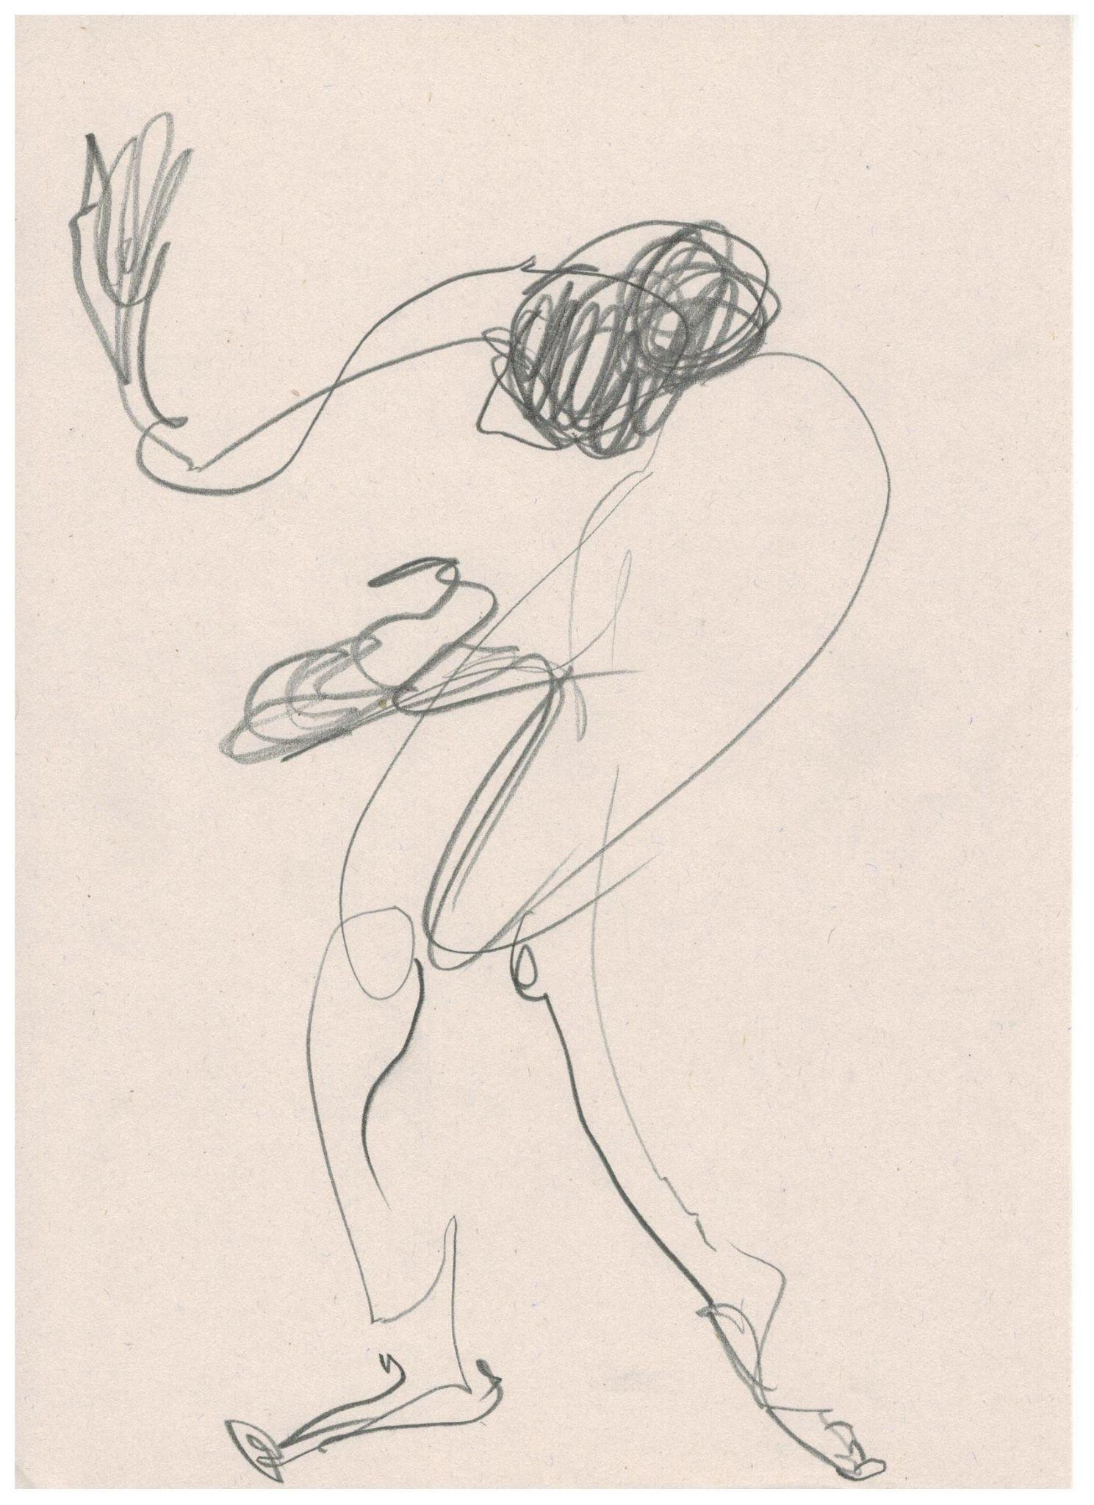
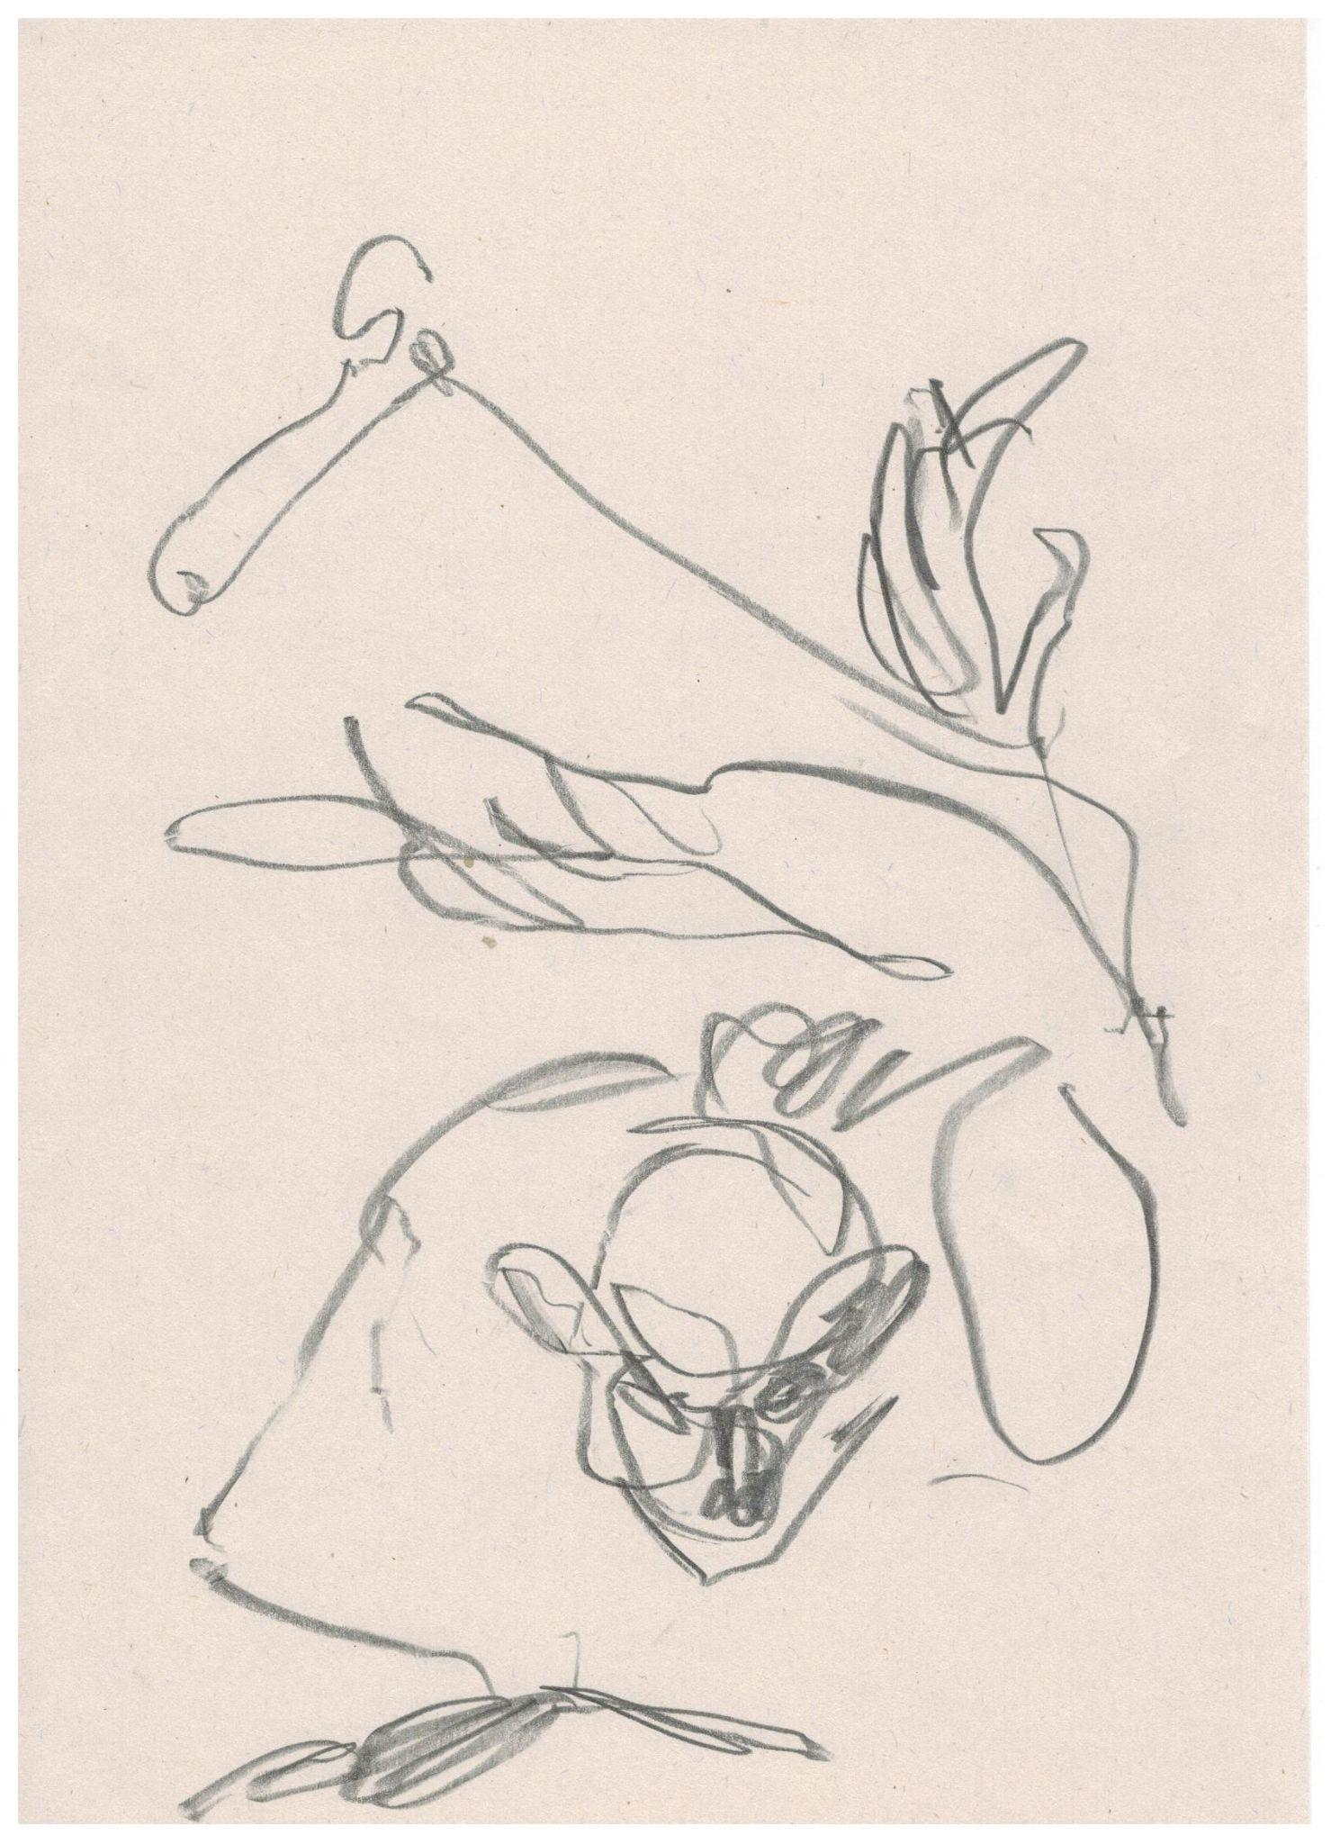

Slide 9
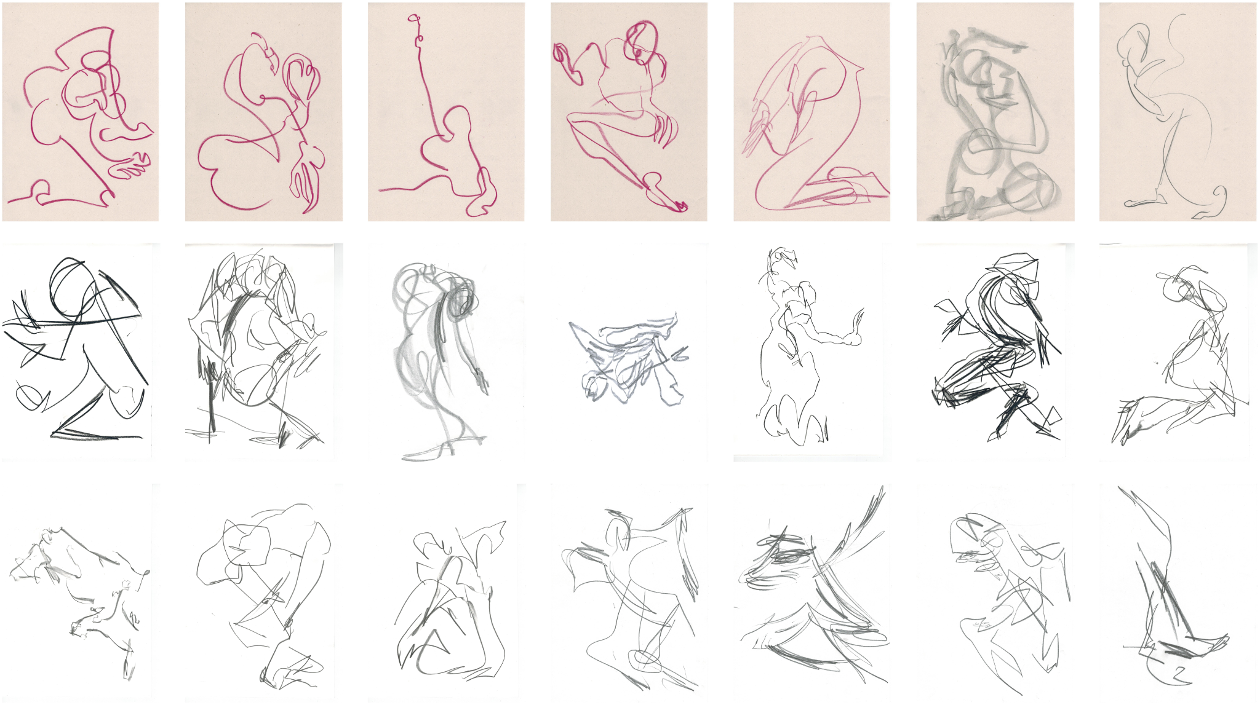

Slide 10
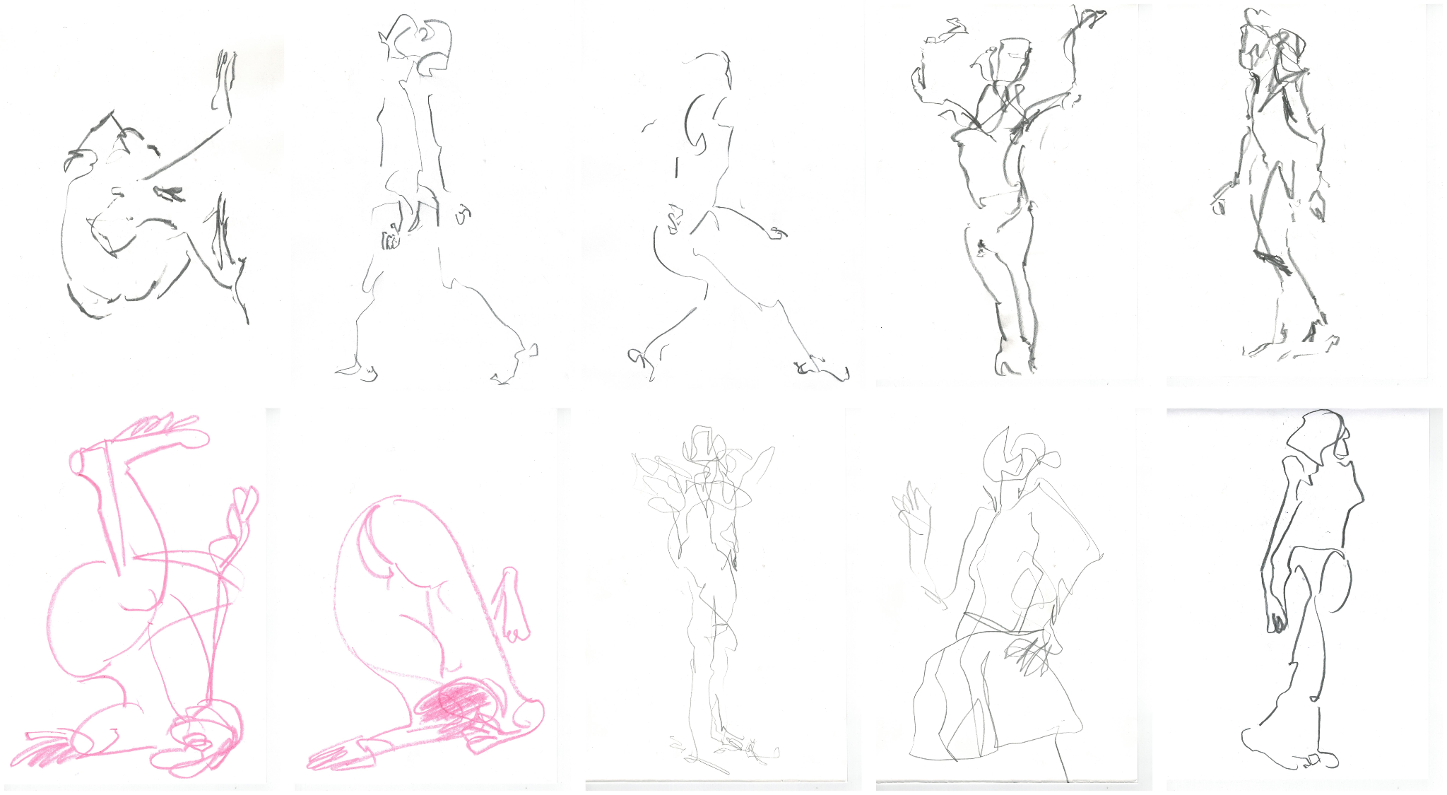

Slide 11
